Slide 1



Natural language processing to capture person-first or identity-first language
Notes:
I wondered about giving ESHG some credit, but not sure

Slide 2
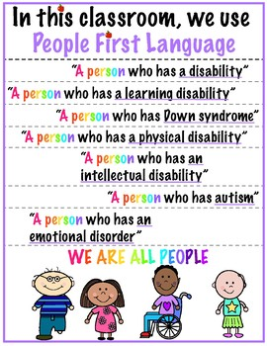
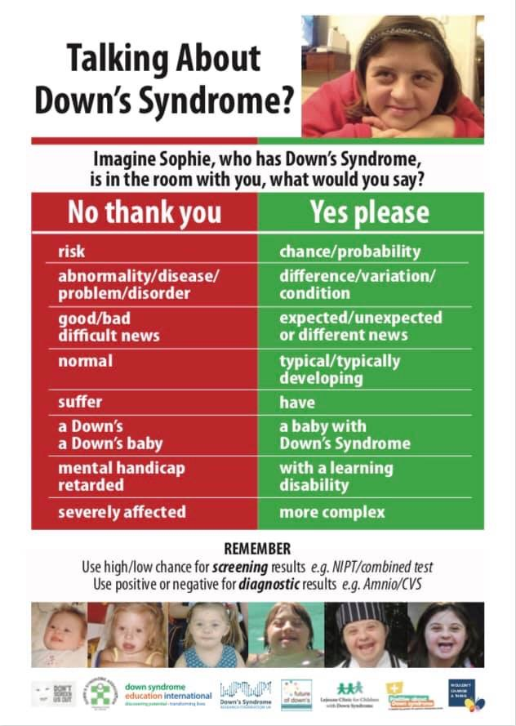
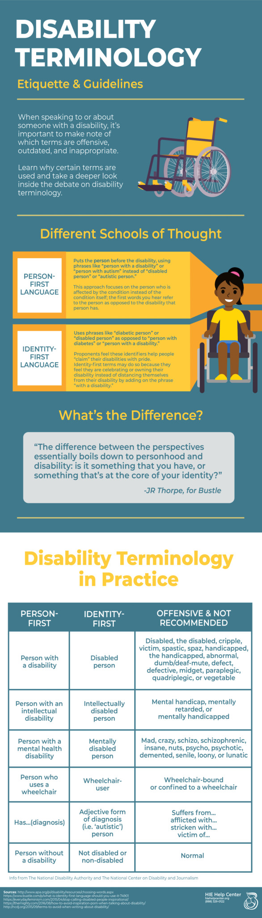
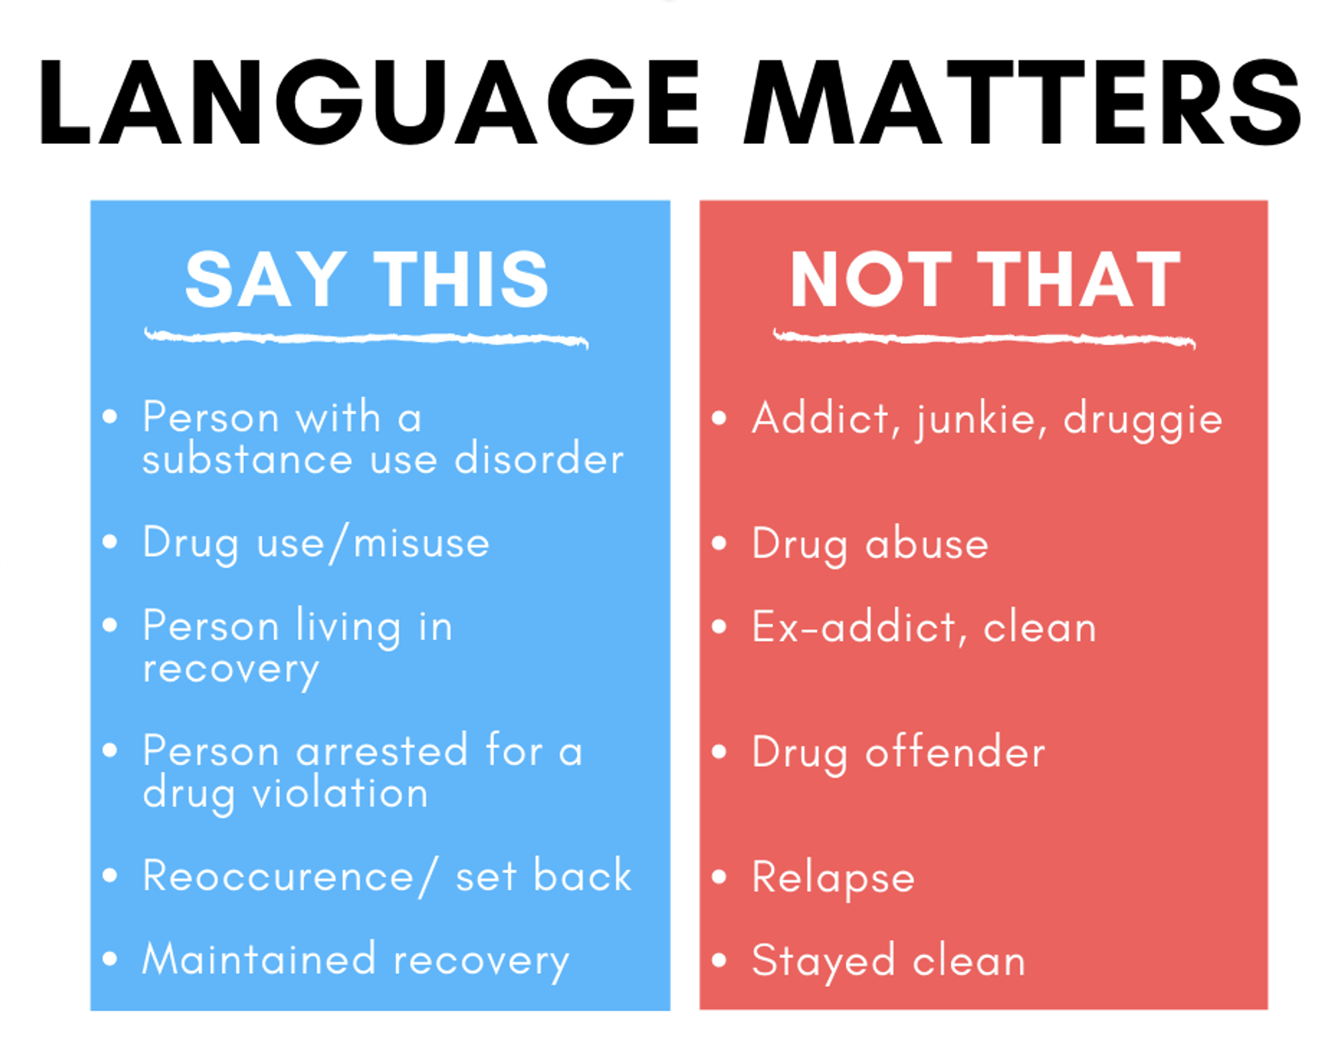
Notes:
You mat not want this, and this may not be needed as the 3rd speaker is a clinician and will bring the clinical/families perspective in

Slide 3

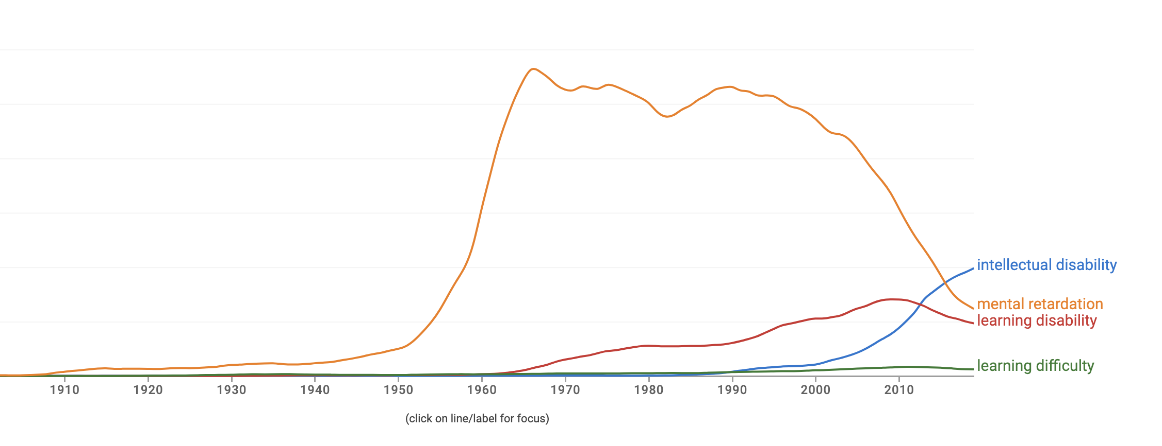
Notes:
Again, not sure if you think this is helpful, only if you want to highligh how languages changes over time

Slide 4
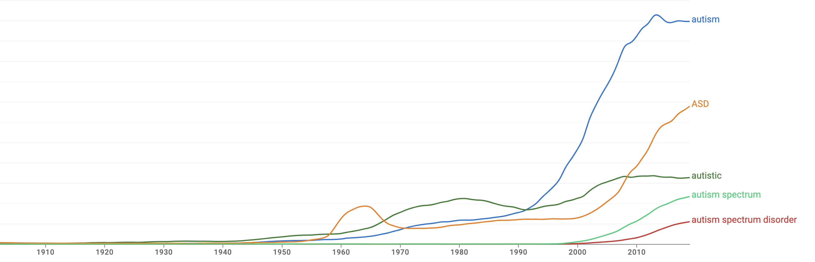

Slide 5
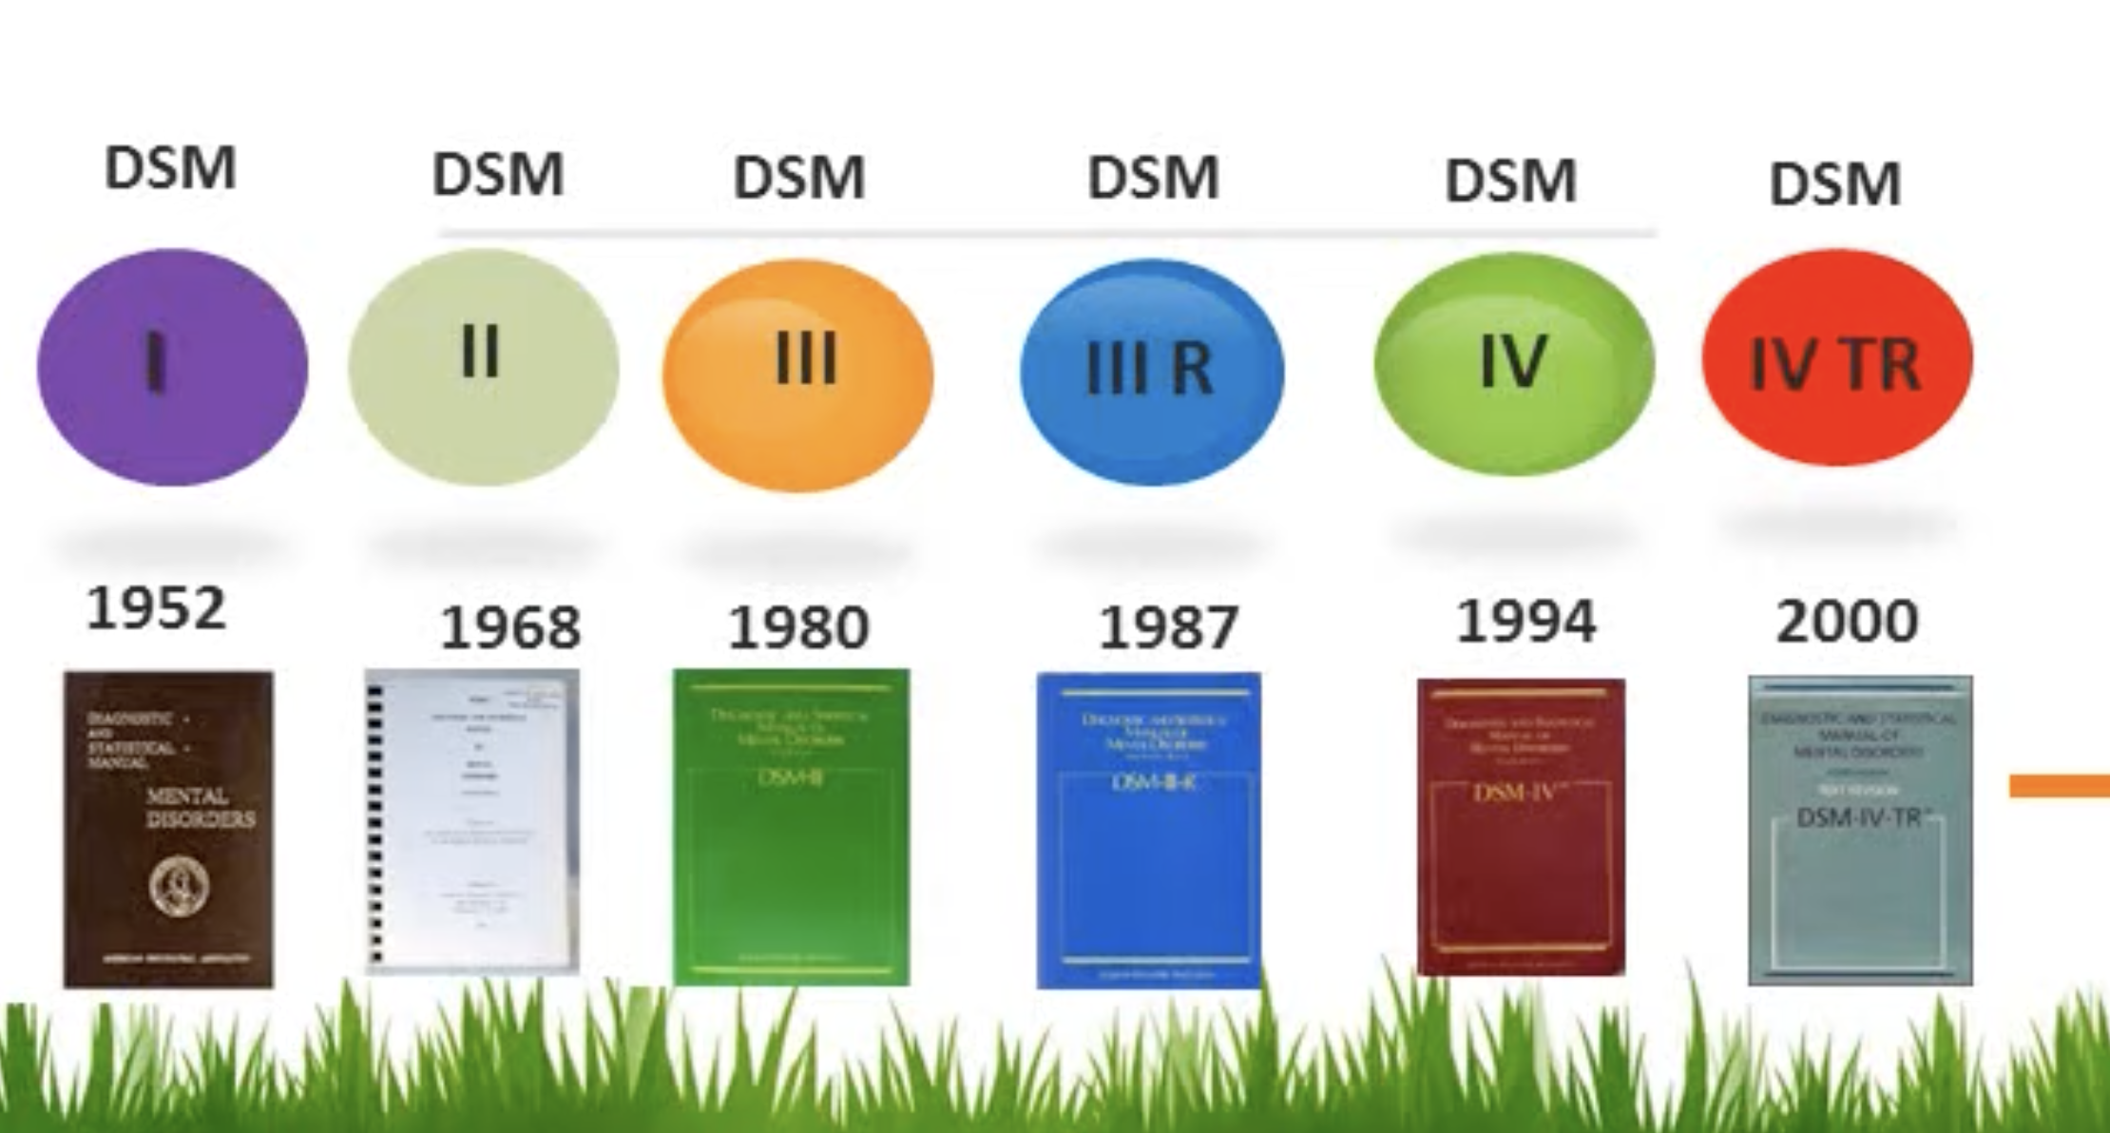
Notes:
And this was just to show why languege often changes, the impact manuals have. A bit didactic, probably not needed

Slide 6
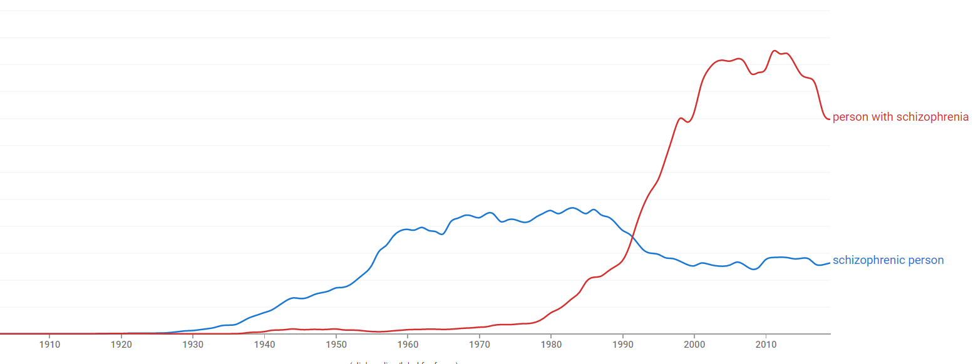
Notes:
A few examples, these ones might be interesting to mention?

Slide 7
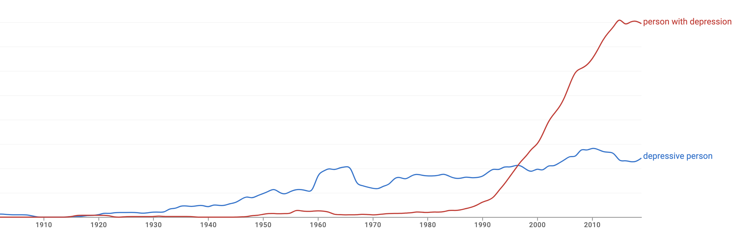

Slide 8
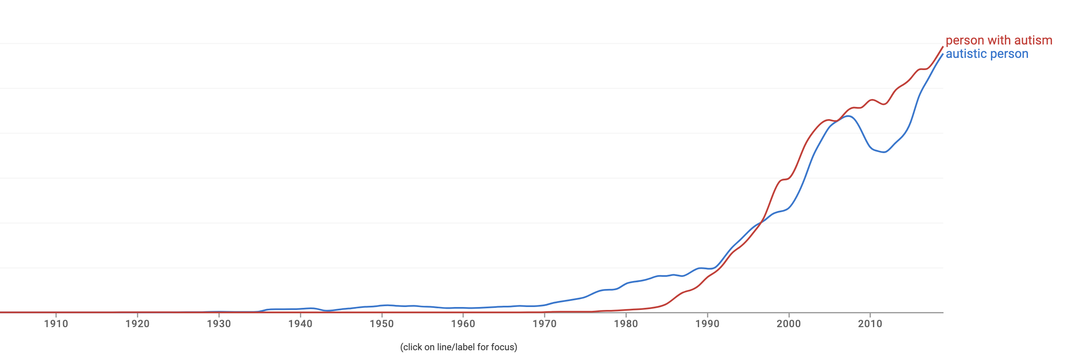

Slide 9
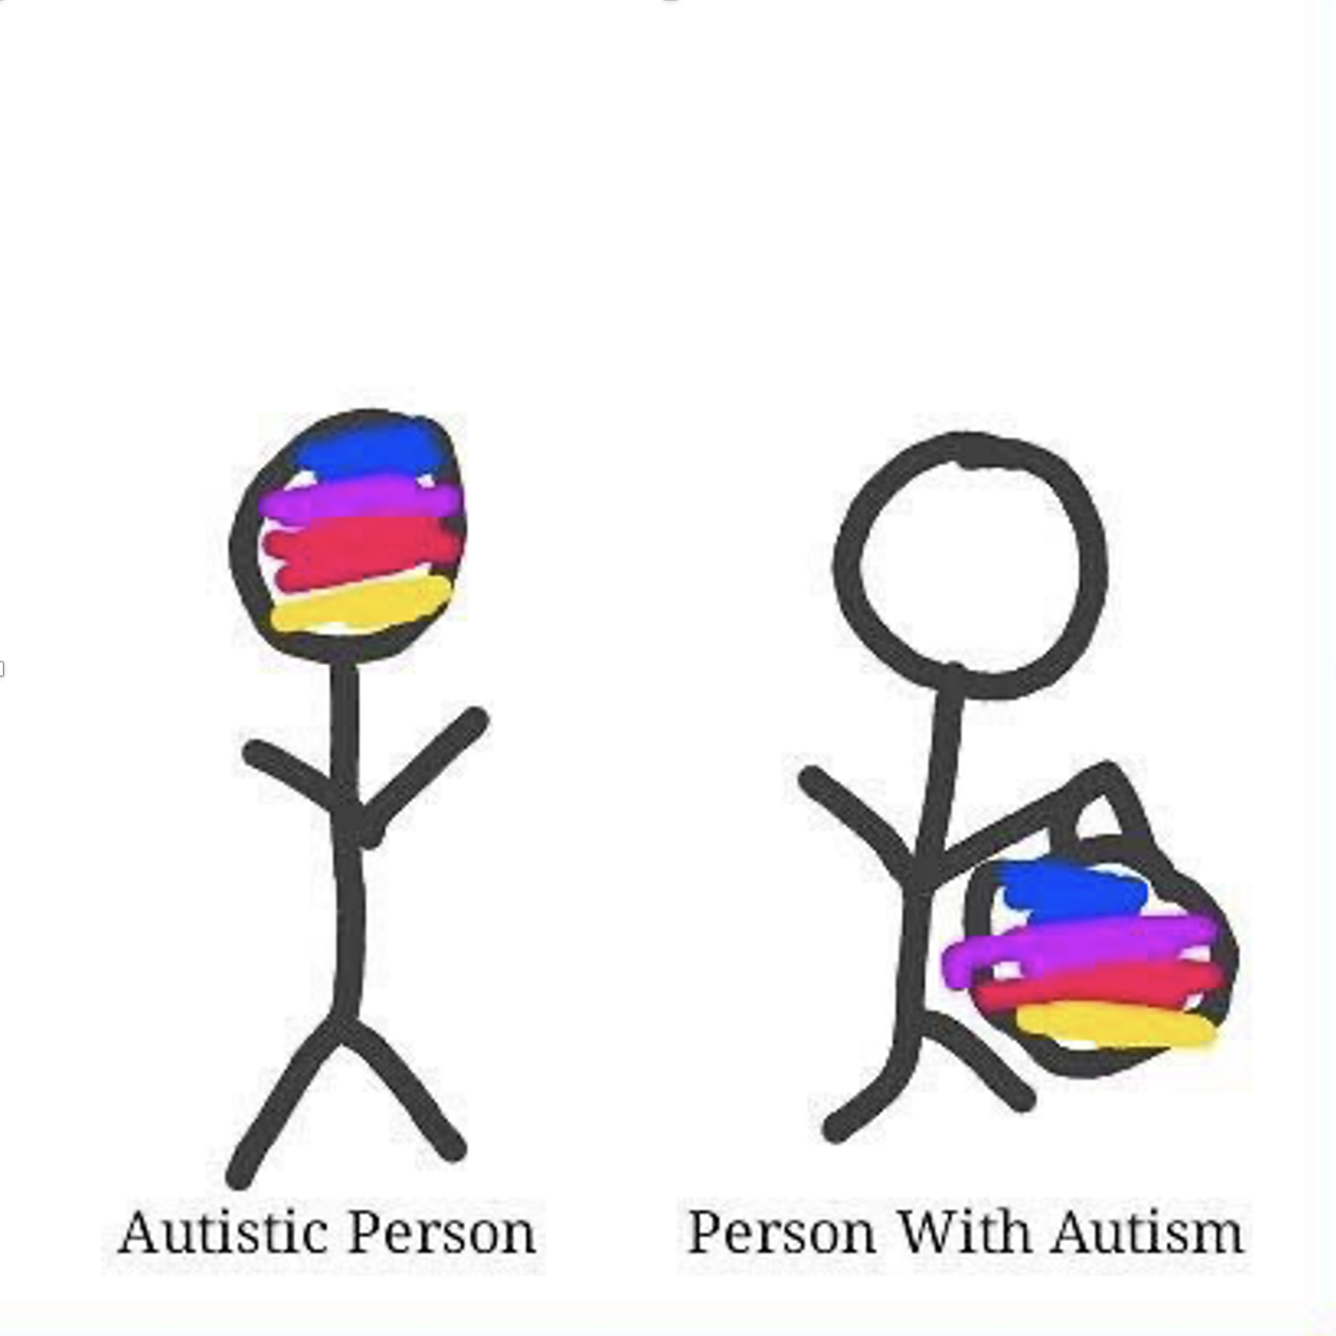
Notes:
Love this ☺

Slide 10
Person First Language
Person-first language (‘70s) proposed to highlight that disability is one component of a person’s identity, rather than the defining feature
Describes what a person has, rather than what a person is
*person with autism
Notes:
Something around PFL / IFL is probably needed, you may have better slides/text

Slide 11
Identity First Language
Describes what a person is, rather than what a person has
Some traits/conditions may be identity-defining features that cannot be separated from the individual & person first language might in fact perpetuate stigmatising views
*autistic person
Notes:
Various conditions are/should be portrayed as neutral (or even positive) attribute, and not a medical problem that requires cure

Slide 12
Euphemism treadmill
Process by which euphemisms become negative, pejorative, or taboo

Slide 13
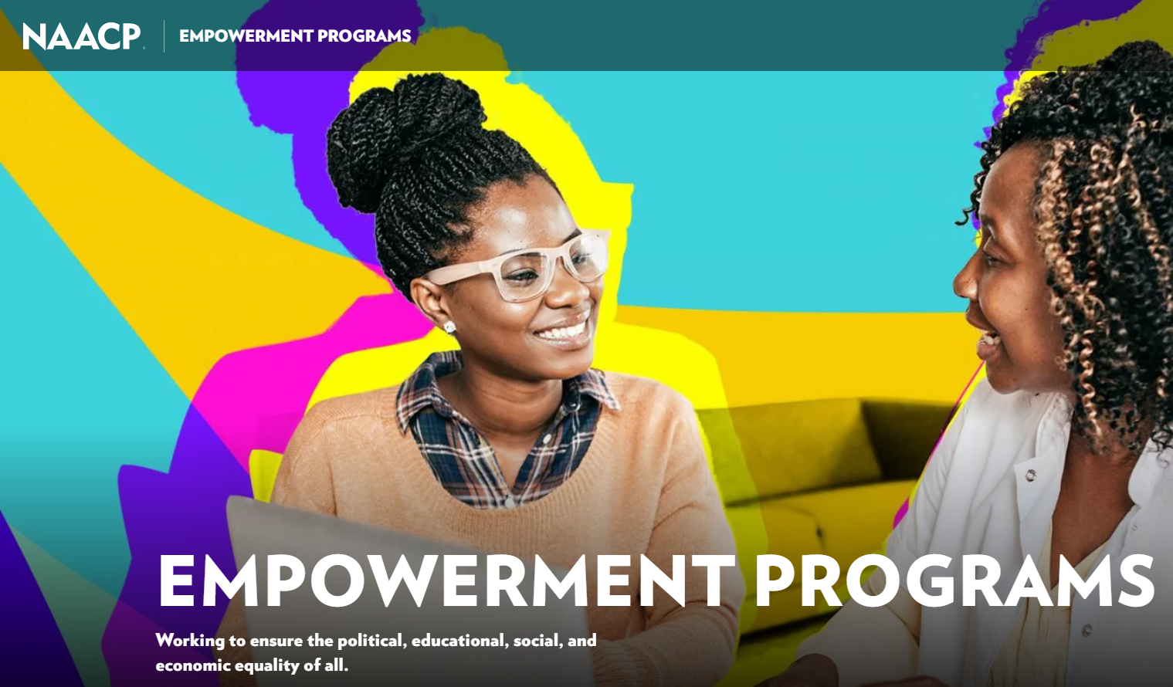
Euphemism treadmill example

Slide 14
Reclaiming euphemisms?
Sometimes people prefer the “offensive” terms
țigan / tzigane
More negative connotations than “roma” but used by some members to refer to themselves without offence
queer
Originally meaning “strange” or “peculiar”, then used as a pejorative, later reclaimed as a deliberatively provocative term
Notes:
Not sure we need this / have time for this? You will know best depending on what else goes in

Slide 15
What wording do you tend to use?
Autistic person Person with autism
Notes:
I think a Mentimeter exercise still good to include

Slide 16
What wording do you tend to use?
Diabetic people People with diabetes

Slide 17
What wording do you tend to use?
Deaf person
Person with deafness
Person with hearing loss
Hearing impaired person
Person with hearing impairment

Slide 18
What wording do you tend to use?
Infertile couples Couples with infertility issues

Slide 19
What wording do you tend to use?
Person with brown eyes Brown eyed person

Slide 20
What wording do you tend to use?
People with dwarfism
Dwarf
People of short stature
Short statured people
People with achondroplasia
Little people

Slide 21
What wording do you tend to use?
Intelligent person Person with intelligence
Notes:
I suppose this would be an example of we tend to use IFL when the adjective is seen as ‘positive’

Slide 22
Our objective is to analyse the use of person-first / identity-first language in genetics research
175,000 abstracts
across 20 years
natural language processing methods
explore language evolution across time & identify potential influencing factors
Pilot study looking at data focused on *autism*
Notes:
I think it would be good to have an intro to this project

